Slide 1
College of Western Idaho SWDV 210 Introduction to Server Side Programming
Week 1 Day 2

Slide 2
SWDV 210 – Day 2 Agenda
Day 2 Topics
Demonstration
Day 2 Lab

Slide 8
Superglobal that is always accessible, regardless of scope from any function, class or file without having to do anything special
Array of variables passed to the current script via the URL parameters

Slide 9
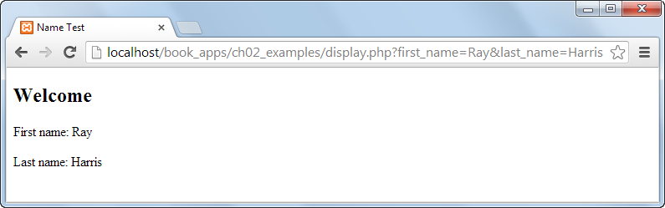
Names are passed in URL

Slide 10
Multi-line
Inline

Slide 15
What is the difference between a variable and a constant?

Slide 17
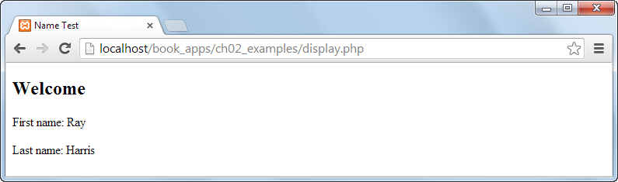
Names are NOT passed in URL

Slide 19
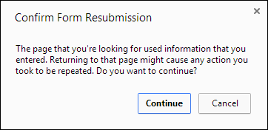

Slide 22
Security feature that converts some predefined characters to HTML entities

Slide 23
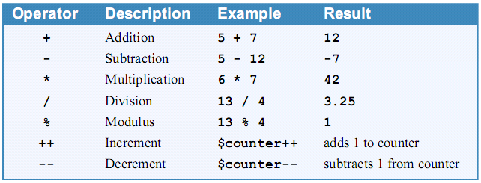

Slide 25
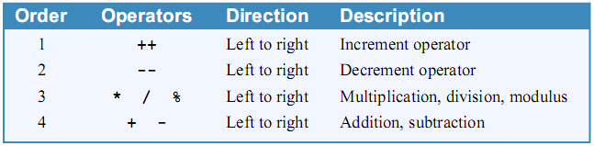

Slide 26
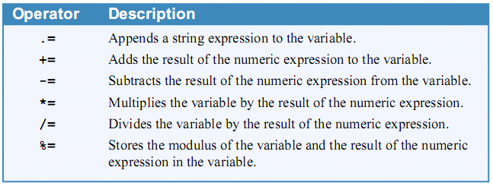

Slide 31
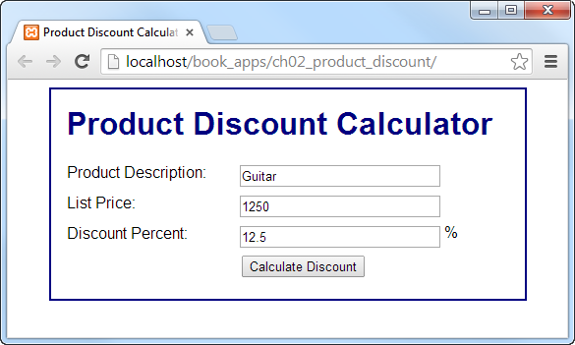

Slide 32
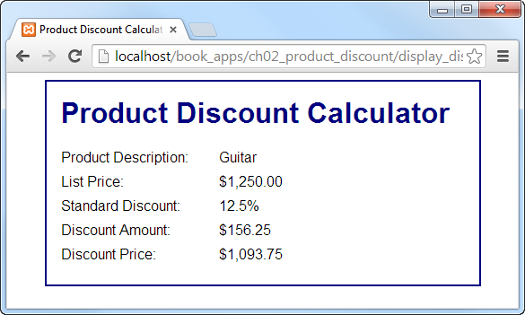

Slide 40
Notes:
In NetBeans: File | New File | PHP File | filename: ch2examples | Finish
Copy, replace & view in browser:
<!DOCTYPE html>
<html>
<head>
<title>Chapter 2 Examples</title>
<link rel="stylesheet" type="text/css"
href="main.css"/>
</head>
<body>
<h2>Chapter 2 Examples</h2>
<?php
$counter = 1;
$message = "";
while ($counter <= 5) {
$message = $message . $counter . '|';
$counter++;
}
echo $message;
// $message = 1|2|3|4|5|
?>
</body>
</html>

Slide 41
Notes:
Add to ch2examples:
<?php
$message2 = "";
for ($counter = 1; $counter <= 5; $counter++) {
$message2 = $message2 . $counter . '|';
}
// $message = 1|2|3|4|5|
echo $message2;
?>

Slide 42
Notes:
Add to ch2examples:
</br>
<?php
$investment = 1000;
$interest_rate = .1;
$years = 25;
$future_value = $investment;
$i = 1;
while ($i <= $years) {
$future_value =
($future_value + ($future_value * $interest_rate));
$i++;
}
echo $future_value;
?>

Slide 43
Notes:
Add to ch2examples:
</br>
<?php
$investment2 = 1000;
$interest_rate2 = .1;
$years2 = 25;
$future_value2 = $investment2;
for ($i2 = 1; $i2 <= $years2; $i2++) {
$future_value2 =
($future_value2 + ($future_value2 * $interest_rate2));
}
echo $future_value2;
?>

Slide 44
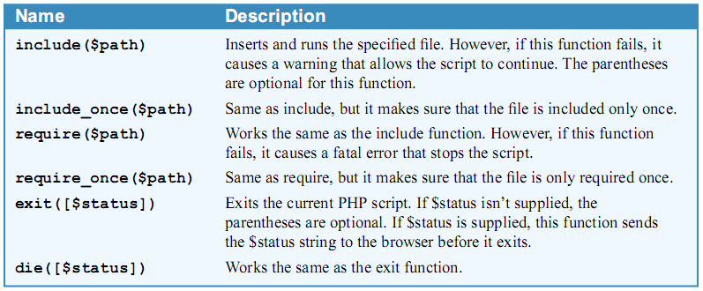

Slide 47
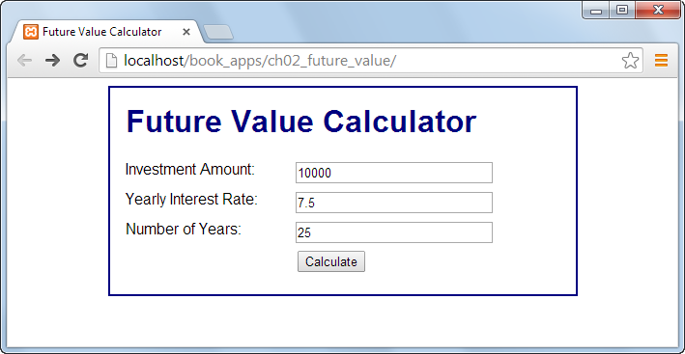
Notes:
Open http://localhost/book_apps/ch02_future_value/

Slide 48
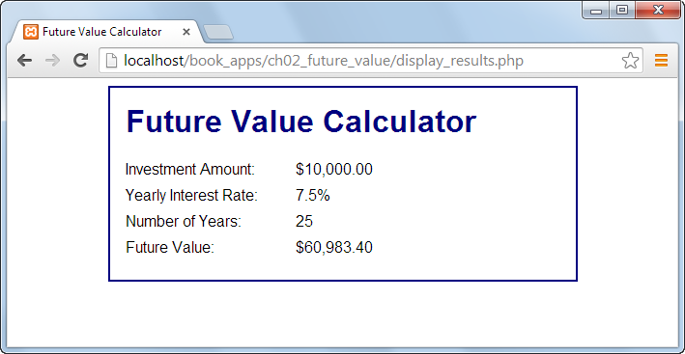

Slide 49
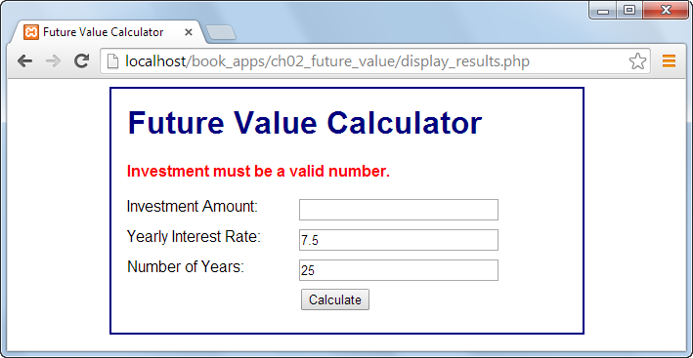

Slide 50
Isset: Boolean test used to determine if a variable has a value
Empty: Boolean test used to determine if a variable is empty - returns true if the variable is an empty string, false, array(), NULL, "0", 0, and an unset variable
Notes:
Is_null function: Opposite of isset. Boolean test returns true only when the variable is null.

Slide 57
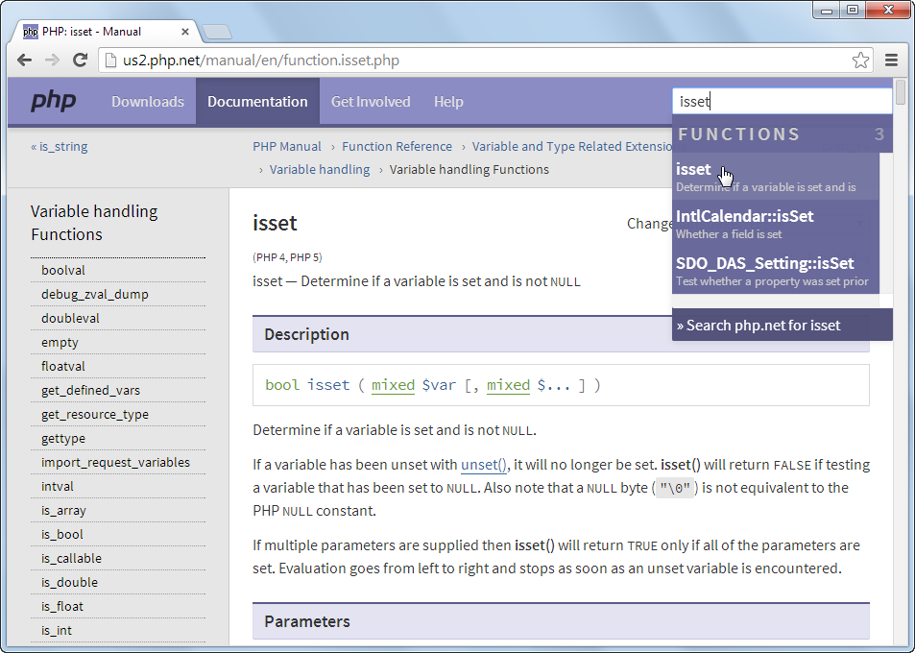

Slide 59
SWDV 210
Questions?

